Slide 1

Money Honey Financial Services Pvt. Ltd.
Mid Cap Mutual Fund

Slide 2
Agenda
Where it stands?
Key terms of Mid cap
Mid cap funds for whom?
Disadvantages
How to select mid cap fund
Mid cap risk and positional return
Tax implications

Slide 3
1. Where it stands?

Slide 4
Where it stands?
Large
cap
Mid cap
Small cap
Top 1st to 100th co. in terms of market capitalization
101st to 250th co. in terms of market capitalization
251st onwards co. in terms of market capitalization

Slide 5
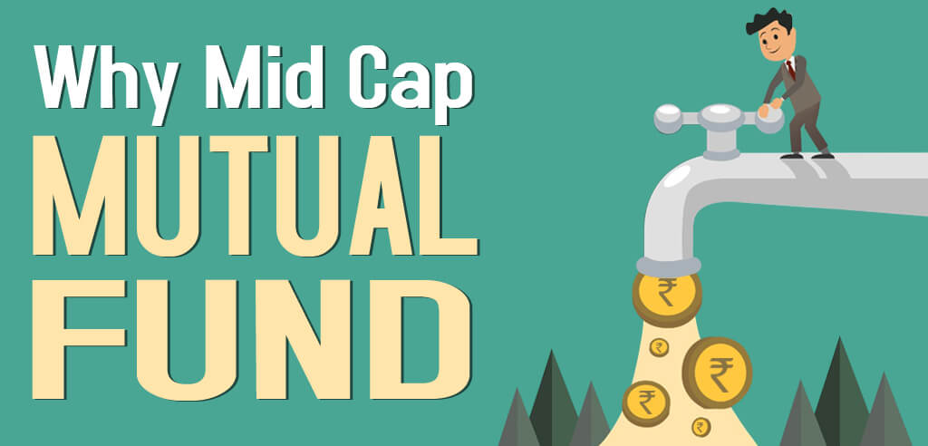

Slide 6
2. Key terms of Mid cap fund

Slide 7
Key terms of Mid cap
Mid cap funds have potential to grow & increase by profit, productivity & market share.
Mid cap funds tend to less risky than small cap & higher than large cap.
Mid cap funds mainly focuses on co.'s. with scalable business models.
Mid cap funds may offer better returns if invested for a extended period.
Mid cap Co.'s. have the potential to be the large caps of tomorrow.

Slide 8
3. Mid cap funds for whom?

Slide 9
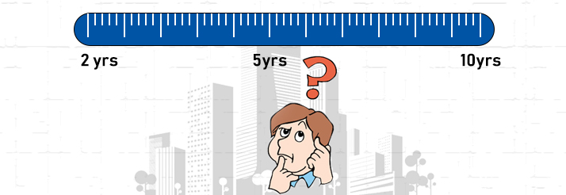
Mid cap funds for whom??
Who are willing to invest for longer period
Mid cap funds have potential to give high returns in longer tenure, so investors with long term goals can select these funds.
Long term goals can be buy house/vehicle, marriage, child education, foreign trip, retirement plan etc.
Those who can wait for longer tenure more than 5 years with willing to get higher returns can go with mid cap funds.
Mid cap funds may not give better returns for shorter tenure.

Slide 10

Mid cap funds for whom??
Those are willing to fathom the volatility in Mid cap.
There are investors who are even though aware of how mid cap market reacts, can invest money to experience the volatility in willing to get high returns.
Volatile market have potential to deliver higher return as compared to large cap funds.
Those have patience to fathom the volatility in mid cap, can invest.

Slide 11

Mid cap funds for whom??
Useful for young investors to benefit from the power of compounding
Mid caps has potential to deliver high returns in long term.
Youngsters can save more in their early earning age and have several years in hand to enjoy benefit of power of compounding.
With their long term goals like buying house, retirement plan etc. can enjoy power of compounding.
Compounding means generating income from your original investments and on accumulated interest.

Slide 12

Mid cap funds for whom??
Those have patience to experience market fluctuation.
Mid caps funds tend to more volatile than large cap funds.
Most of investors play safe with their money and has no patience to experience how market fluctuates.
But those with patience with willing to get high returns can invest in mid cap .
Mid cap funds looks risky compared to large cap but potential to deliver high returns in longer tenure.

Slide 13


Slide 14
4. Disadvantages

Slide 15

Disadvantages
Mid cap funds may give less returns and growth potential compared to small cap
Mid cap funds can be high risky than large cap funds
During crisis, Mid cap stocks hurting investors badly
Mid caps may not suitable for shorter tenure

Slide 16
5. How to select Mid cap fund

Slide 17
How to select Mid cap fund
Evaluate at least for 3-5 years past performance of the fund
Analyze the track record of Fund manager
Set your long term priorities, mid caps may not suitable for short term goals.
Can take help from financial advisors to create portfolio
Select scheme as per your income, expenses, age, financial goals.

Slide 18
6. Mid cap risk and positional return

Slide 19
Mid cap risk and positional return
Potential Return
Small Cap
Lower To Higher
Mid Cap
Focused
Multi Cap
Large & Mid Cap
Large Cap
Lower To Higher
Risk

Slide 20
7. Tax implications

Slide 21
Tax implications
Tax implication
Capital gain tax
STCG
A holding period of up to one year.
STCG is taxed at 15%.
LTCG
A holding period of more than one year.
There is no tax on LTCG of up to Rs. 1 lakh above that 10% tax
Direct distribution tax
DDT 10% to be deducted before paying dividend to unitholders

Slide 22


Slide 23


Thank You

